Slide 1

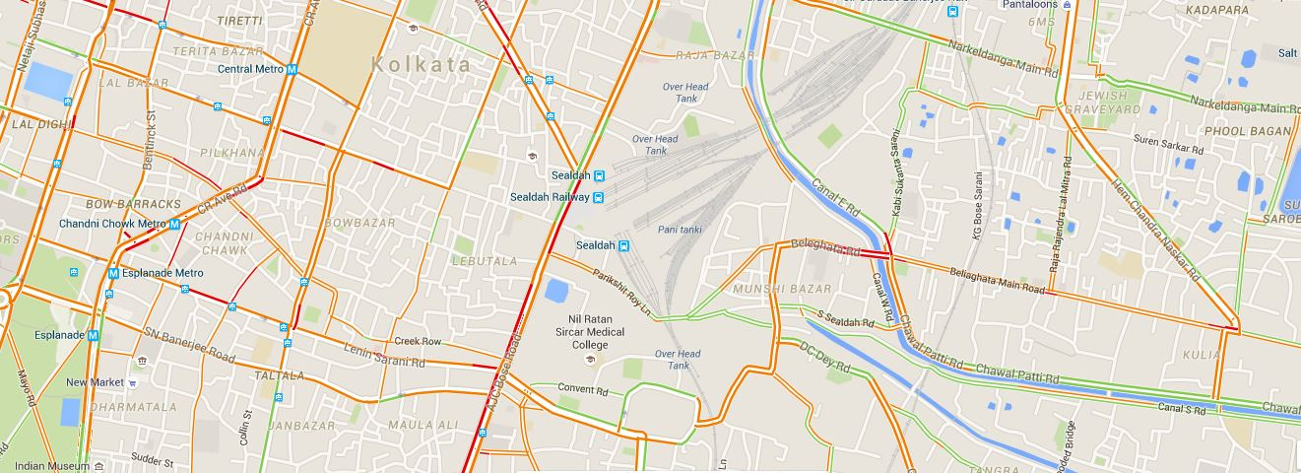
Cab Travel Time Predicti n
- Based on historical trip observation

Slide 2
Problem Definition
Opportunity
New Booking - Time of Arrival
Value
Accurate Travel Time Prediction
Shortest Route (Distance/Time)
Increased Fuel Efficiency
Optimized Utilization of Cabs
Taxi-Passenger Demand Distribution
Our project involves developing a model for predicting the travel time for a particular cab along different routes in a rectangular map of Porto. The output is based on several factors, like –
day of the week,
time of the day and other features
derived from Floating Car Data.

Slide 3
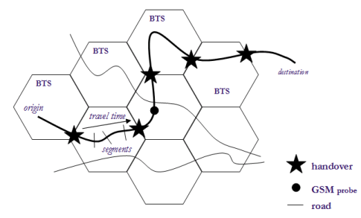
Floating car Data estimation
Floating car data are position fixes of vehicles traversing city streets throughout the day.
Advantages
Most Inexpensive Data
Generally very accurate (GPS)
Disadvantages
FCD is usually sampled infrequently
High Density of data is required to get meaningful travel time predictions.
Trajectories of Single Vehicles,
Location and Time of Lane Changes,
Traffic Density (vehicles per kilometer),
Traffic Flow (vehicles per hour),
Vehicle Speed
Length and Position of Traffic Jams
Use

Slide 4
Data Description
The dataset contained 9 features and a total of 17,10,760 observations of various parameters of taxi movement on Porto, Portugal.
Features :
TRIP_ID: (String) It contains an unique identifier for each trip.
CALL_TYPE: (Char) It identifies the way used to demand this service.
ORIGIN_CALL: (Integer) It contains an unique identifier for each phone number which was used to demand, at least, one service. It identifies the trip’s customer if CALL_TYPE=’A’. Otherwise, it assumes a NULL value.
ORIGIN_STAND: (Integer): It contains an unique identifier for the taxi stand.
TAXI_ID: (Integer): It contains an unique identifier for the taxi driver that performed each trip.

Slide 5
Data Description
The dataset contained 9 features and a total of 17,10,760 observations of various parameters of taxi movement on Porto, Portugal.
Features :
TIMESTAMP: (Integer) Unix Timestamp (in seconds). It identifies the trip’s start.
DAYTYPE: (Char) It identifies the type of the day in which the trip starts. (Holiday, Day before Holiday, Weekday)
MISSING_DATA: (Boolean) It is FALSE when the GPS data stream is complete and TRUE whenever one (or more) locations are missing.
POLYLINE: (String): It contains a list of GPS coordinates (i.e. WGS84 format) mapped as a string. Each pair of coordinates is of the form [LONGITUDE, LATITUDE].
For Prediction of Time we have considered Timestamp and Polyline.
The rows having missing value are not considered in our calculations.

Slide 6
Prediction Architecture
Brief overview of the various processing steps required
Motion Detection
Directed Graph
Supervised Learning
Prediction
Grid Matching

Slide 7

Prediction Architecture
Motion Detection
Since the incoming streams of traffic data come from taxi cabs, delivery vehicles, or other commercial fleet vehicles, there will always be a certain amount of ambiguity between a slowdown in traffic and a commercial stop by the vehicle. (i.e. for a taxi customer, or a delivery vehicle dropping off packages). Therefore, any further processing must clean out all unwanted stops that are in the GPS logs. The most common and intuitive technique, and that which is used in this project is to track the number of consecutive GPS points that are less than a specified distance D_{max} from each other.

Slide 8
Prediction Architecture
Grid Matching
Grid Matching is a widely studied problem in transportation research is perhaps the most computationally difficult and important subcomponent.
Input: {x₁ , y₁ , t₁}
Output: {i₁ , t₁}

Slide 9


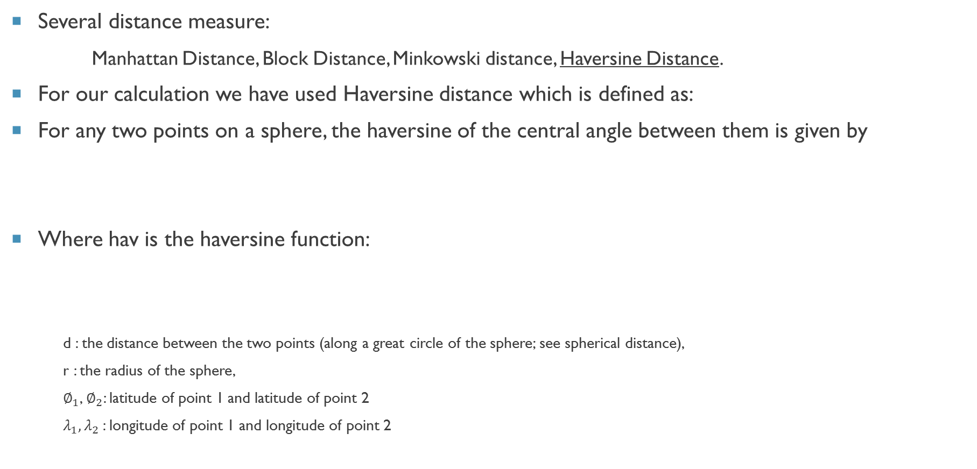
Prediction Architecture
Several distance measure:
Manhattan Distance, Block Distance, Minkowski distance, Haversine Distance.
For our calculation we have used Haversine distance which is defined as:
For any two points on a sphere, the haversine of the central angle between them is given by
Where hav is the haversine function:
d : the distance between the two points (along a great circle of the sphere; see spherical distance),
r : the radius of the sphere,
$∅_{1}$, $∅_{2}$: latitude of point 1 and latitude of point 2
$λ_{1},λ_{2}$: longitude of point 1 and longitude of point 2

Slide 10
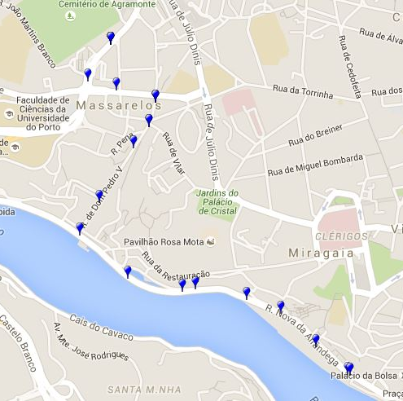
Prediction Architecture
Directed Graph
After Grid Matching of polyline covered by each training observation, we get a series of nodes and edges. Thus a directed graph is constructed using the grid points as nodes and velocity or time as edges.
Input: {i₁ , t₁}
Process:
e_{1,2} = t₂-t₁
e_{1,2} = (Haversine distance) / (t₂-t₁)
Output: Sparse Matrix M = {e_{i,j}} for all i , j

Slide 11
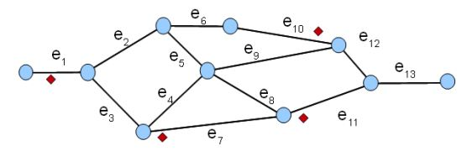
Prediction Architecture
Supervised Learning
Decision Tree Classifier, Decision Tree Regression, Random Forest Regression, Historical Mean
Process:
The whole day is categorized in x units.
The timestamp of each edge and the time/velocity is fed into the system.
The output gives us a predicted value for a corresponding timestamp value.
Output: Sparse Matrix M = {e_{i,j}} for all i, j at that timestamp.

Slide 12
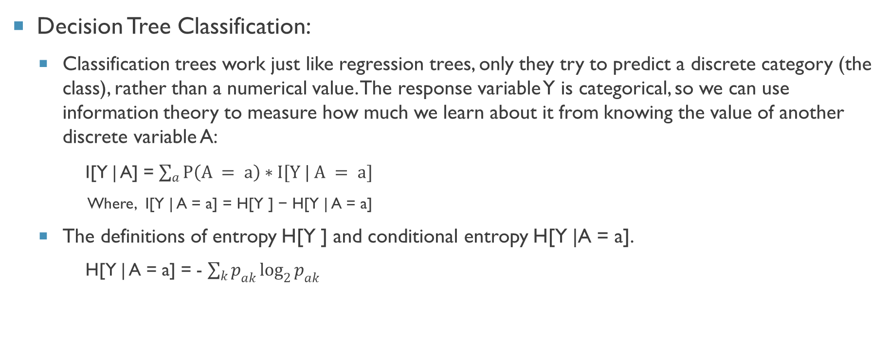
Prediction Architecture
Decision Tree Classification:
Classification trees work just like regression trees, only they try to predict a discrete category (the class), rather than a numerical value. The response variable Y is categorical, so we can use information theory to measure how much we learn about it from knowing the value of another discrete variable A:
I[Y | A] = $\sum_{a}{P\left(A = a\right)∗I[Y | A = a]}$
Where, I[Y | A = a] = H[Y ] − H[Y | A = a]
The definitions of entropy H[Y ] and conditional entropy H[Y |A = a].
H[Y | A = a] = - $\sum_{k}{p_{ak}\log_{2}{p_{ak}}}$

Slide 13
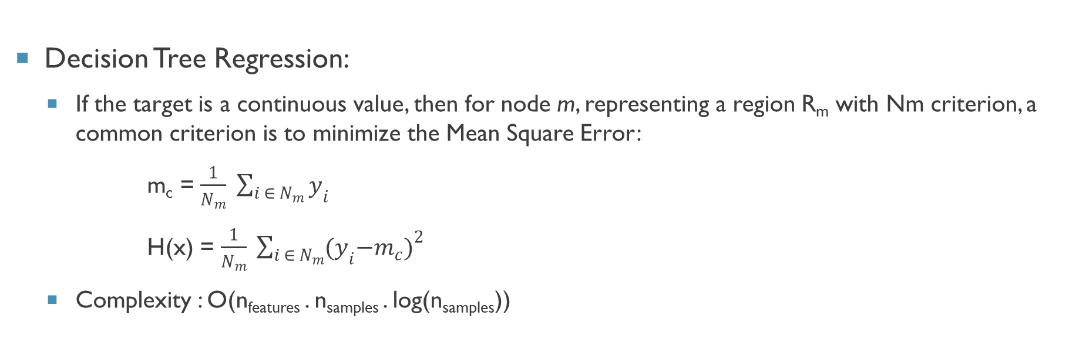
Prediction Architecture
Decision Tree Regression:
If the target is a continuous value, then for node m, representing a region R_{m} with Nm criterion, a common criterion is to minimize the Mean Square Error:
m_{c} = $\frac{1}{N_{m}} \sum_{i ∈ N_{m}}{y_{i}}$
H(x) = $\frac{1}{N_{m}} \sum_{i ∈ N_{m}}{{{(y}_{i}−m_{c})}^{2}}$
Complexity : O(n_{features} . n_{samples} . log(n_{samples}))

Slide 14
Prediction Architecture
Random Forest Regression:
Here, each tree in the ensemble is built from a sample drawn with replacement (i.e., a bootstrap sample) from the training set.
Disadvantage: In addition, when splitting a node during the construction of the tree, the split that is chosen is no longer the best split among all features. Instead, the split that is picked is the best split among a random subset of the features. As a result of this randomness, the bias of the forest usually slightly increases (with respect to the bias of a single non-random tree)
Advantage: But, due to averaging, its variance also decreases, usually more than compensating for the increase in bias, hence yielding an overall better model.

Slide 15
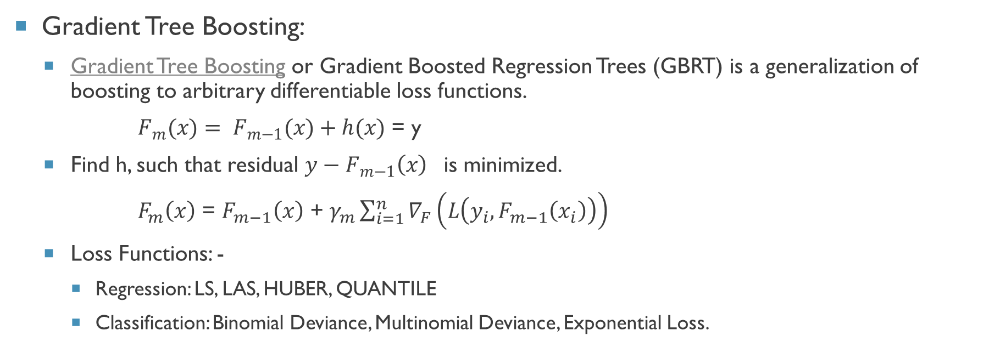
Prediction Architecture
Gradient Tree Boosting:
Gradient Tree Boosting or Gradient Boosted Regression Trees (GBRT) is a generalization of boosting to arbitrary differentiable loss functions.
$F_{m}(x)= F_{m−1}(x)+h(x)$ = y
Find h, such that residual $y−F_{m−1}\left(x\right)$ is minimized.
$F_{m}\left(x\right)$ = $F_{m−1}\left(x\right)$ + $γ_{m}\sum_{i=1}^{n}{∇_{F}\left(L\left(y_{i},F_{m−1}\left(x_{i}\right)\right)\right)}$
Loss Functions: -
Regression: LS, LAS, HUBER, QUANTILE
Classification: Binomial Deviance, Multinomial Deviance, Exponential Loss.

Slide 16
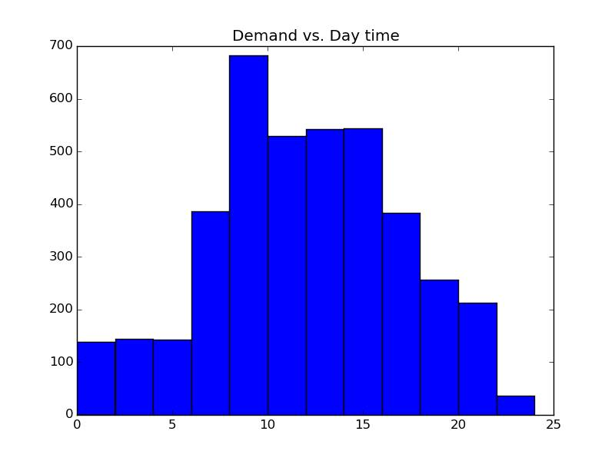
Data inference
The Demand distribution of taxi along the daytime is shown here.
Highest peak is at the range of 9 to 10 A.M. (Office Hours)
A steady distribution thereafter till 6 P.M.
Can be utilized to model the value of charge/Km during the course of the day.
Can be used to optimize the model of resource utilization and thereby profit generation.

Slide 17
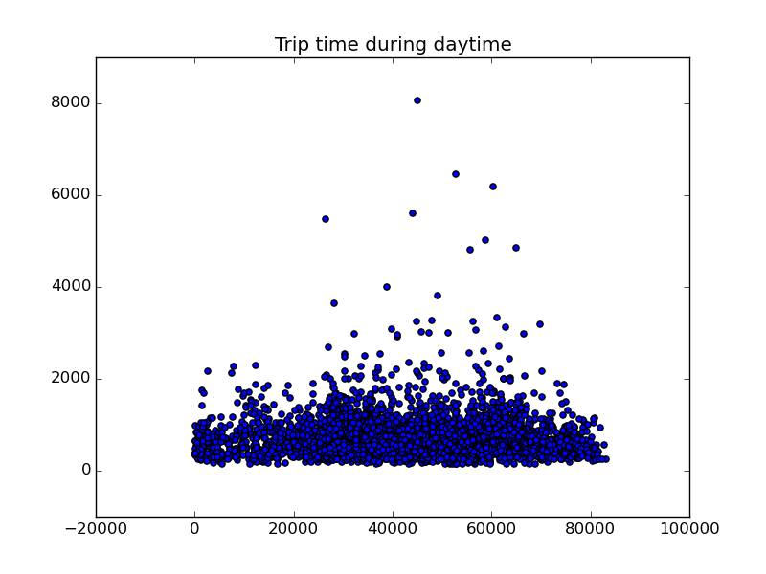
Data inference
Individual trip time during daytime is shown here.
Travelling time of maximum trips are within half an hour.

Slide 18
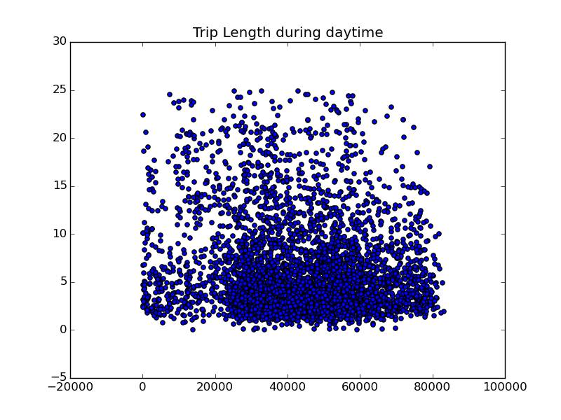
Data inference
The trip time shows a cluster of points in the time domain of 26000 to 82000 corresponding to 7 A.M. and 11 P.M. respectively.
Most of the trip lengths are within 10 km.
This is in conformity with the previous plot of travelling time where most of the travelling time are within half an hour.

Slide 19
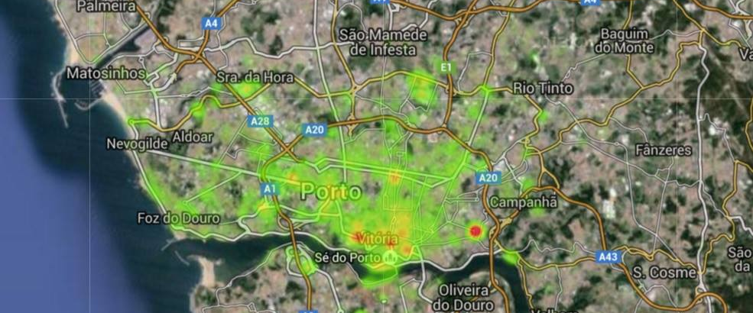
Data inference

Slide 20
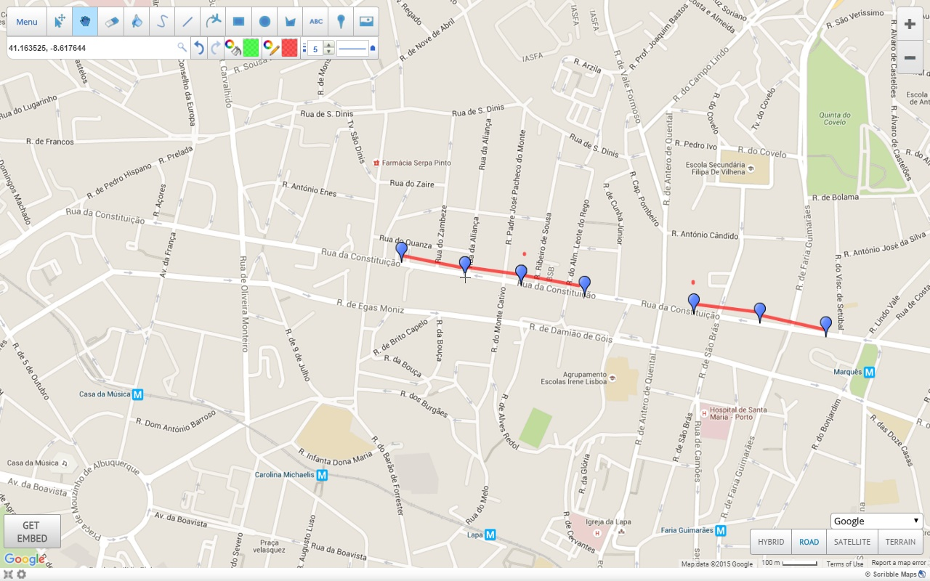
Data inference
Top 5 important road segments of the city are
[[41.162292, -8.60787], [41.162031, -8.60571]]
[[41.16258, -8.61003], [41.162292, -8.60787]]
[[41.163291, -8.6157], [41.163021, -8.613639]]
[[41.163525, -8.617644], [41.163291, -8.6157]]
[[41.163768, -8.619678], [41.163525, -8.617644]]
0.0772321809805613, 0.07708869873451546, 0.07441287173742973, 0.07212227668575326, 0.06932519386480848
Rank | Segment | Centrality
1 | [41.162292, -8.60787], [41.162031, -8.60571] | 0.0772321809805613
2 | [41.16258, -8.61003], [41.162292, -8.60787] | 0.07708869873451546
3 | [41.163291, -8.6157], [41.163021, -8.613639] | 0.07441287173742973
4 | [41.163525, -8.617644], [41.163291, -8.6157] | 0.07212227668575326
5 | [41.163768, -8.619678], [41.163525, -8.617644] | 0.06932519386480848

Slide 21
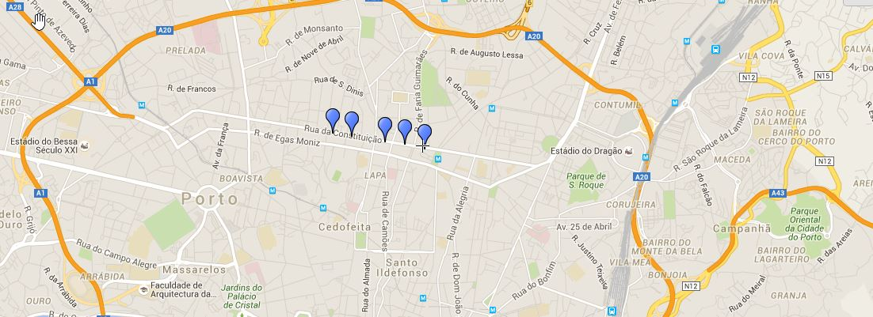
Data inference
Rank | Geo-Location | Centrality
1 | [41.162031, -8.60571] | 0.08277015940786502
2 | [41.162292, -8.60787] | 0.07877967724696255
3 | [41.16258, -8.61003] | 0.07775467831692078
4 | [41.163021, -8.613639] | 0.07690847152899795
5 | [41.163291, -8.6157] | 0.07608514260606453

Slide 22



Performance evaluation
Mean Absolute Percentage Error
The MAPE (Mean Absolute Percent Error) measures the size of the error in percentage terms. It is calculated as the average of the unsigned percentage error.
Mean Absolute Error:
The MAE measures the average magnitude of the errors in a set of forecasts, without considering their direction. It measures accuracy for continuous variables.
Mean Percentage Error:
MPE is the computed average of percentage errors by which forecasts of a model differ from actual values of the quantity being forecast.

Slide 23
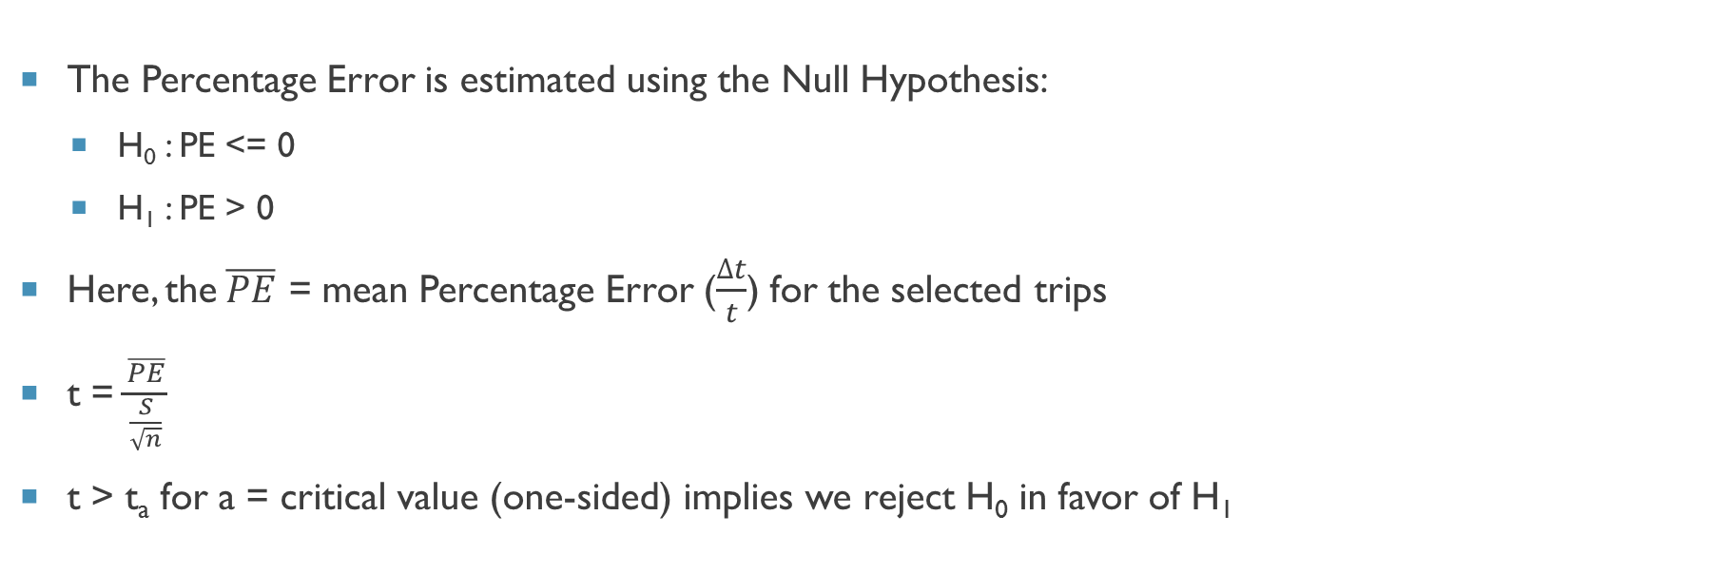
Hypothesis testing (P-value calculation)
The Percentage Error is estimated using the Null Hypothesis:
H₀ : PE <= 0
H₁ : PE > 0
Here, the$\overline{PE}$ = mean Percentage Error ($\frac{∆t}{t}$) for the selected trips
t = $\frac{\overline{PE}}{\frac{S}{\sqrt{n}}}$
t > t_{a} for a = critical value (one-sided) implies we reject H₀ in favor of H₁

Slide 24
Performance evaluation
 | MAPE | MAE | MPE | P-Value
DT(R) | 0.3713 | 252.00s | 0.3556 | 0.999781858
DT(C) | 0.3729 | 253.33s | 0.3365 | 0.999182999
RF(C) | 0.3692 | 253.33s | 0.3933 | 0.999430984
Historical Mean | 0.5899 | 274.24s | -0.3664 | 0.043007171

Slide 25
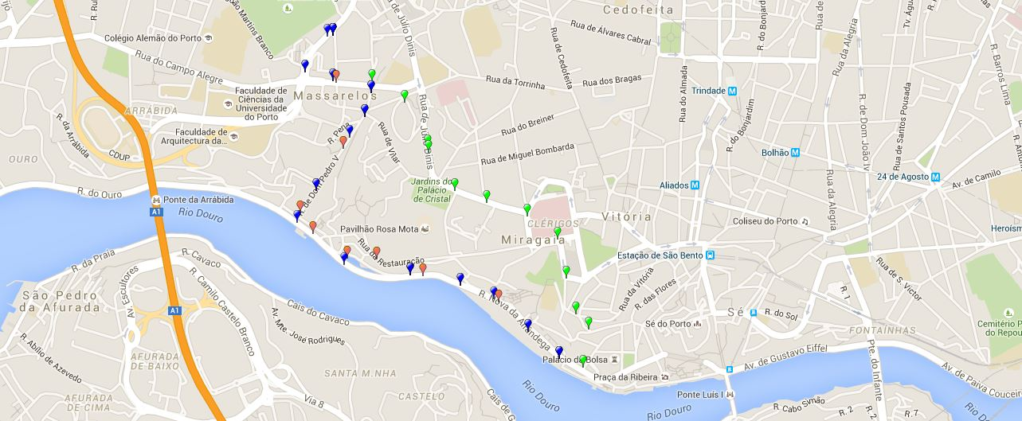
Performance evaluation
Blue | Original Path | 345s
Red | Historical Mean | 467.51s
Green | Decision Tree / Random Forest | 240s

Slide 26
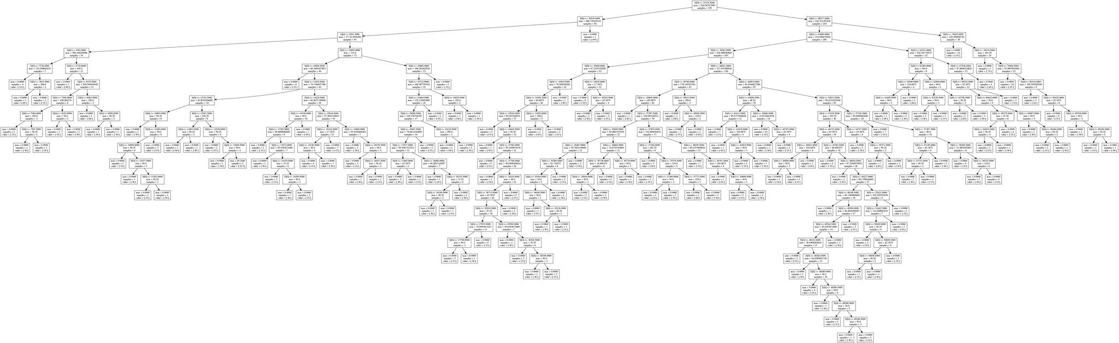
Performance evaluation
Decision Tree

Slide 27
Future Value Addition
Apply an incremental ARIMA model to each segment for a specific time of the day (Data needed)
Use Map Matching Technique to position the standard points on the road accurately.
Real Time Traffic Map (travelling route management, traffic signal optimization etc.)
Optimization of our approach in order to reduce model error.
To make this prediction real time and make better visualization of prediction.
Implement it locally.
Consolidate the Features in an Application

Slide 28
References
http://arxiv.org/pdf/1012.4249.pdf
http://arxiv.org/pdf/1509.05257.pdf
https://en.wikipedia.org/wiki/Haversine_formula
http://toc.proceedings.com/04373webtoc.pdf
http://www.ivt.ethz.ch/oev/ped2012/vpl/publications/reports/ab379.pdf
https://www.kaggle.com/c/pkdd-15-taxi-trip-time-prediction-ii
http://www.galitshmueli.com/data-mining-project/predicting-customer-cancellation-cab-bookings-yourcabscom
http://scikit-learn.org/stable/modules/ensemble.html
https://www.scribblemaps.com/create/#id=srin&lat=41.1619705&lng=-8.60570389999998&z=14&t=road

Slide 29

Thank you

